Slide 1

2020 Company Strategy
ROCKBUSTER STEALTH LLC

Slide 2
Key Questions and Objectives
Which movies contributed the most/least to revenue gain?
What was the average rental duration for all videos?
Which countries are Rockbuster customers based in?
Where are customers with a high lifetime value based?
Do sales figures vary between geographic regions?

Slide 3
Descriptive Statistics
 | Minimum | Maximum | Average
Rental Duration | 3 Days | 7 Days | 4,985 days
Rental Rate | 0,99$ | 4,99$ | 2,98$
Movie Length | 46 Minutes | 185 Minutes | 115,27 minutes
Replacement Cost | 9,99$ | 29,99$ | 19,984$
We have 2 stores based in Canada and Australia.
We have 599 different customers from 109 different countries.
Most movies are PG-13 MPAA rated.

Slide 4
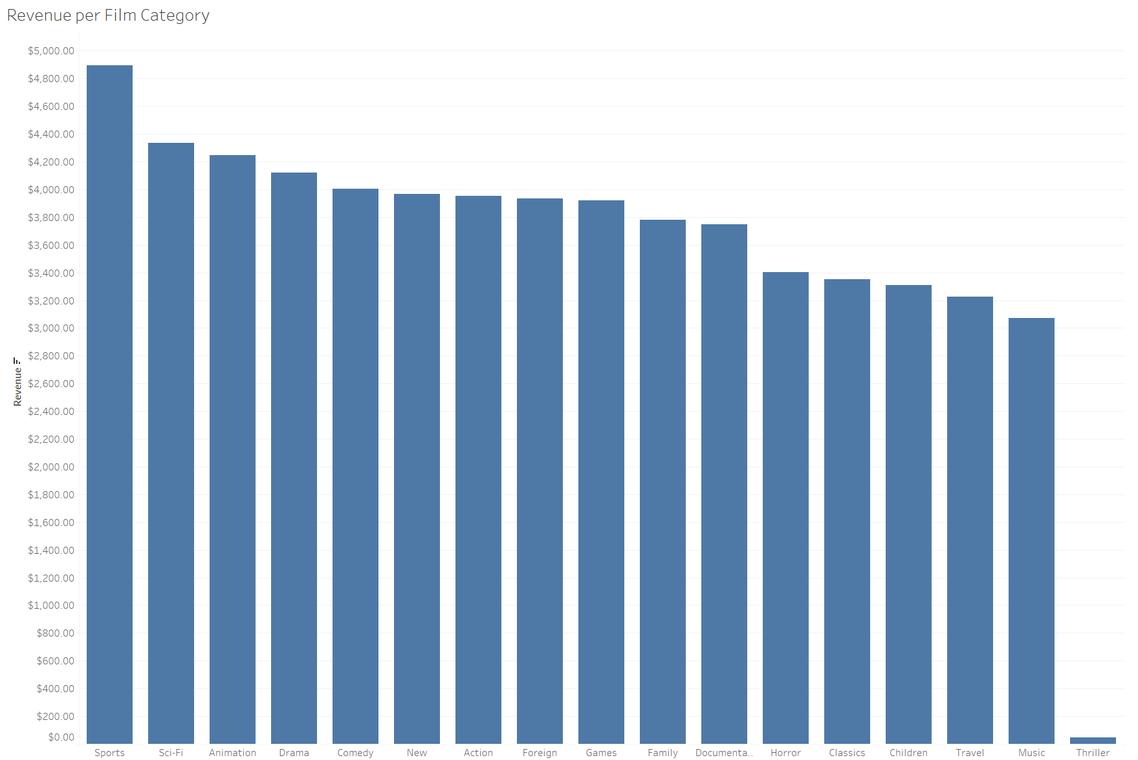
Which movies contributed the most/least to revenue gain?

Slide 5
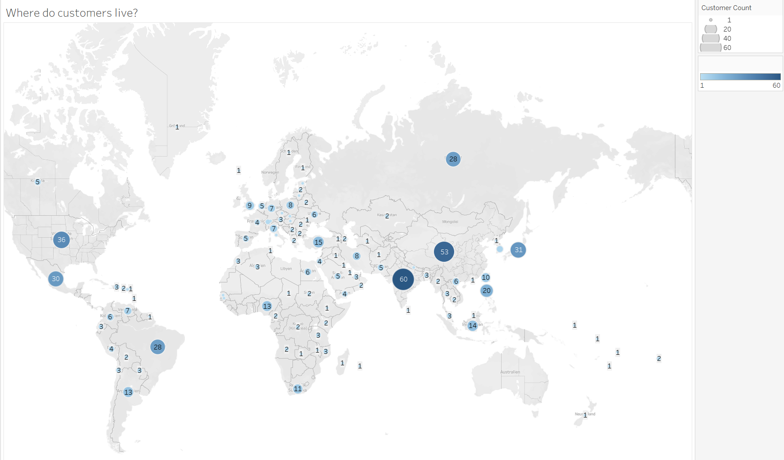
Which countries are Rockbuster customers based in?

Slide 6
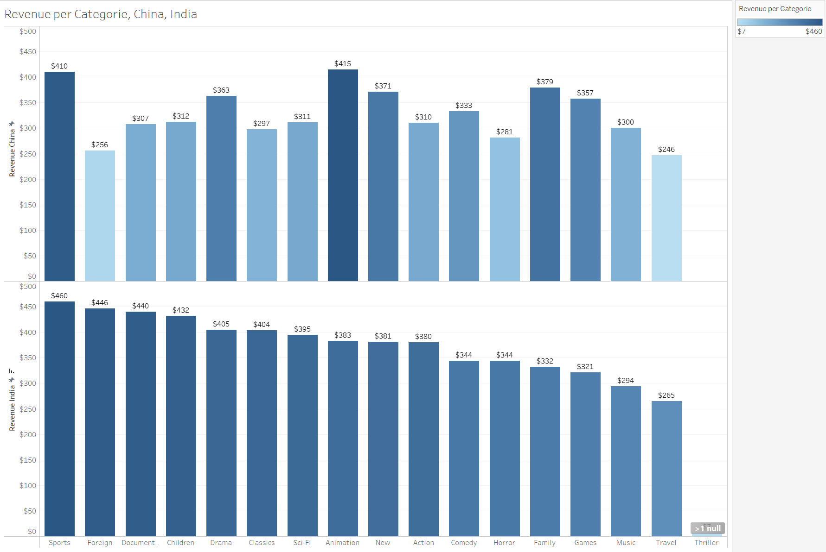
Which Categories have the most Revenue in India and China?

Slide 7
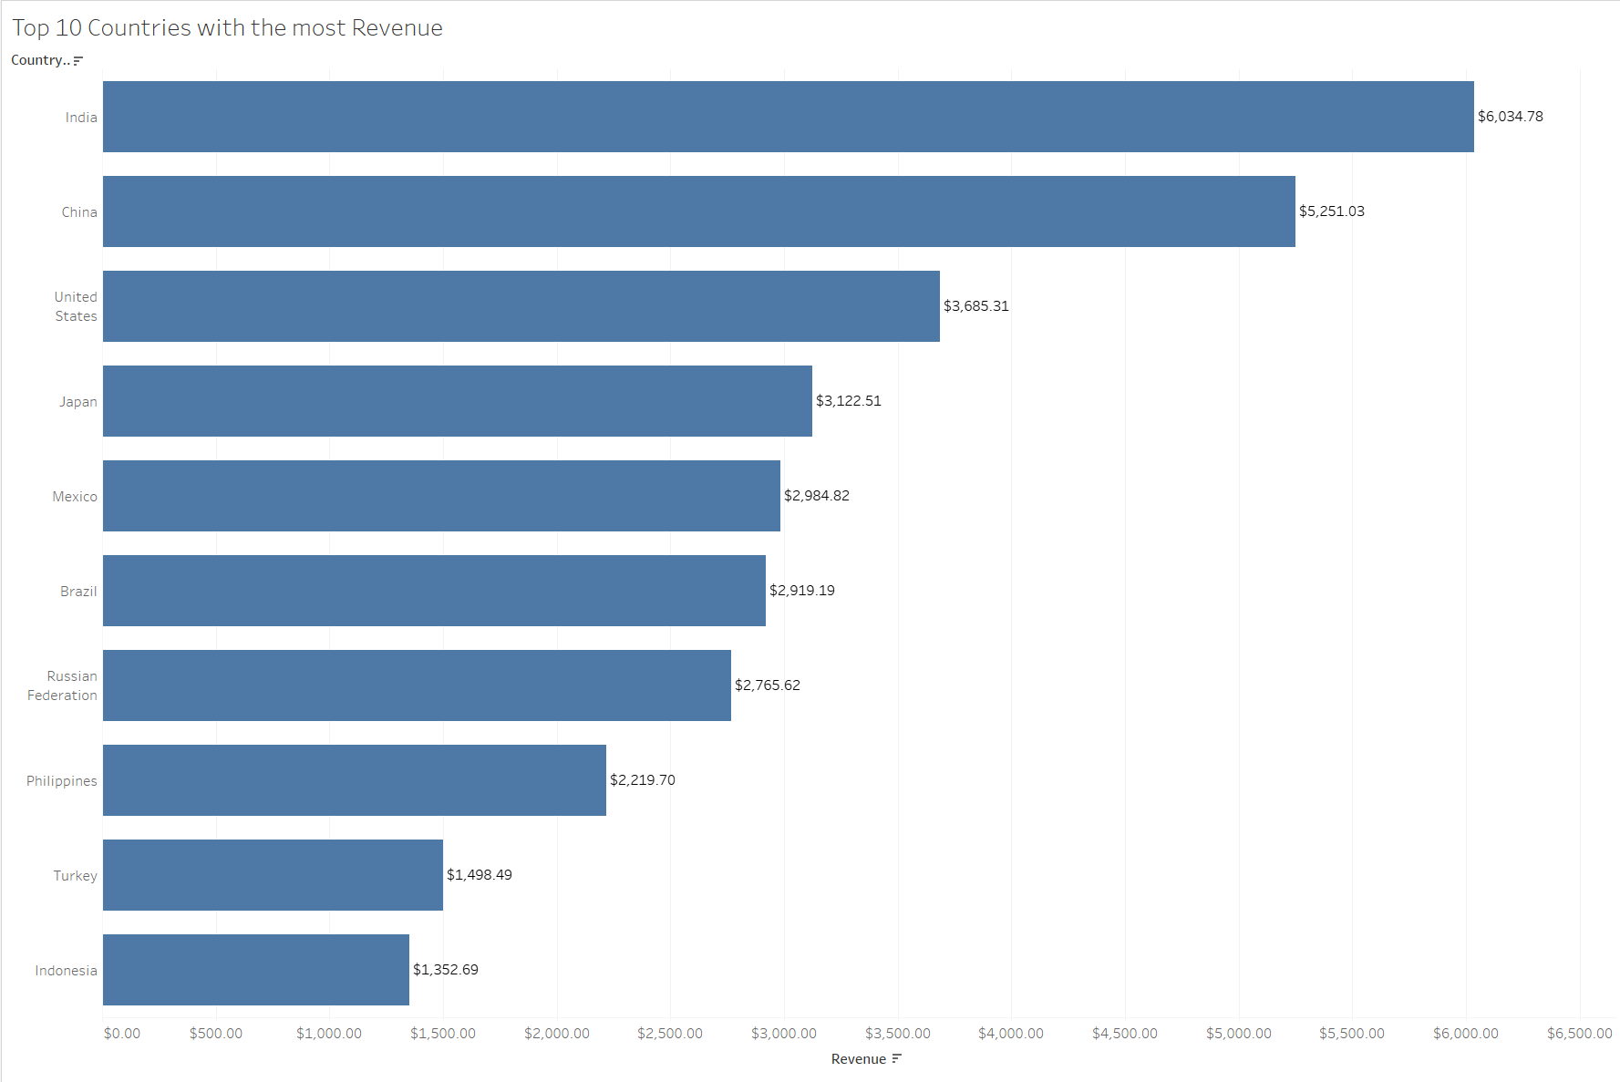
Do sales figures vary between geographic regions?

Slide 8
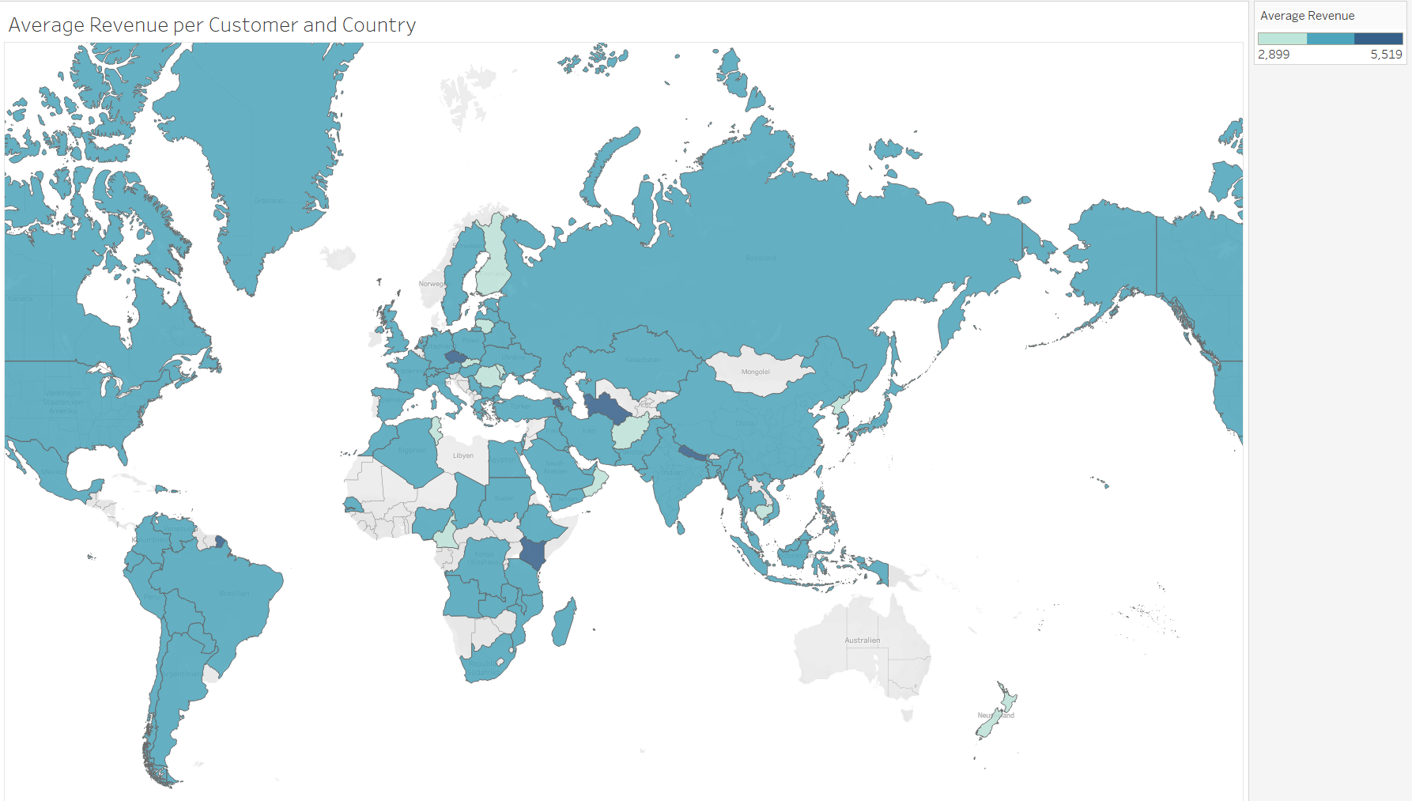
Where are customers with a high lifetime value based?

Slide 9
Who are our top 5 customers in the top 10 cities?
Customer ID | First Name | Last Name | City | Country | Revenue
84 | Sara | Perry | Atlixco | Mexico | 128,70$
518 | Gabriel | Harder | Sivas | Turkey | 108,75$
587 | Sergio | Stanfield | Celaya | Mexico | 102,76$
537 | Clinton | Buford | Aurora | United States | 98,76$
367 | Adam | Gooch | Adoni | India | 97,80$

Slide 10
Recommendations
Focus the marketing budget on India and China‘s top categories:
India (Sports, Foreign, Documentary, Children, Drama)
China (Animation, Sports, Family, New, Drama)
And on countries where customers spend on average the most:
Nepal, French Guiana, Turkmenistan, Kenya, Nauru, Armenia, Czech Republic, Reunion, Chile
Reward the top 5 customers in the top 10 cities:
Sara Perry, Gabriel Harder, Sivas Sergio, Stanfield Celaya, Clinton Buford

